Slide 1

AI and Machine Learning for IoT Big Data

Slide 2
First steps with BD

Slide 3
Lecture 3: Big Data analysis
Statistical foundations
Descriptive statistics
Pitfalls of descriptive statistics
Hypothesis testing for detection
Regression for prediction
Statistic for BD
From statistics to AI

Slide 4
Foundations of Statistics
Data is a representative sample
Parameters calculated from the data help us understand it
Correct selection maximizes the probability of correct decision

Slide 5
Foundations of BD Statistics
Data is a representative sample
Parameters calculated from the data help us understand it
Correct selection maximizes the probability of correct decision
Big Data contains some representative samples
Information extracted from the data helps us understand it
Discovery of crucial parameters maximizes the probability of correct decision
Notes:
BD is often messy, contaminated with noise, needs cleanup and selection
Might require multiple domain knowledge (e.g. medical + engineering + social etc.)
The interesting information needs to be mined out, not obvious
But some tools are common with classical statistical analysis!

Slide 6
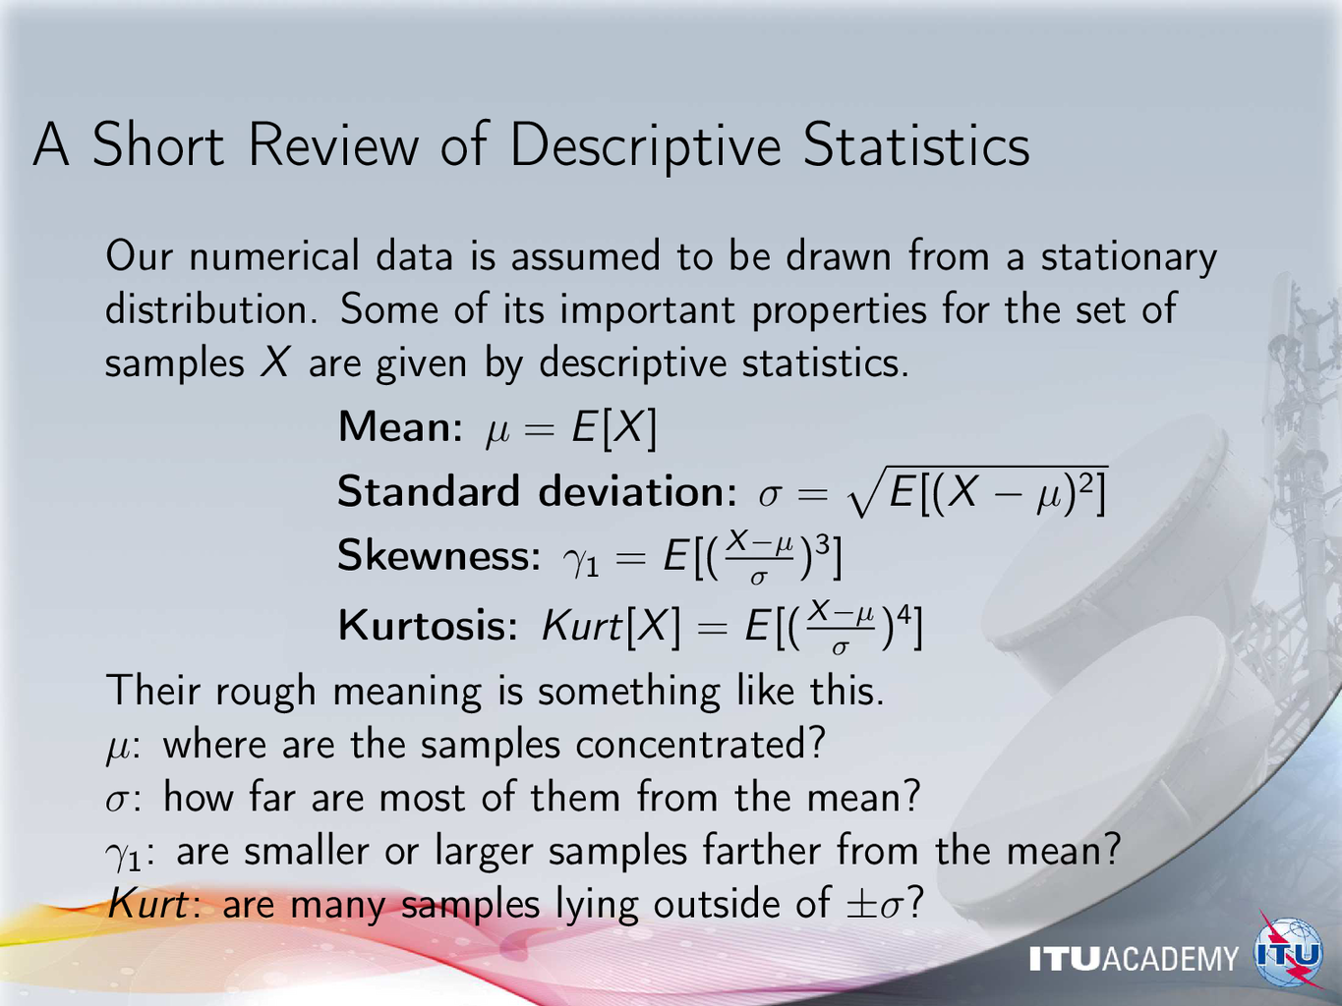
Notes:
These numbers are calculated by Python functions, no need for coding

Slide 7
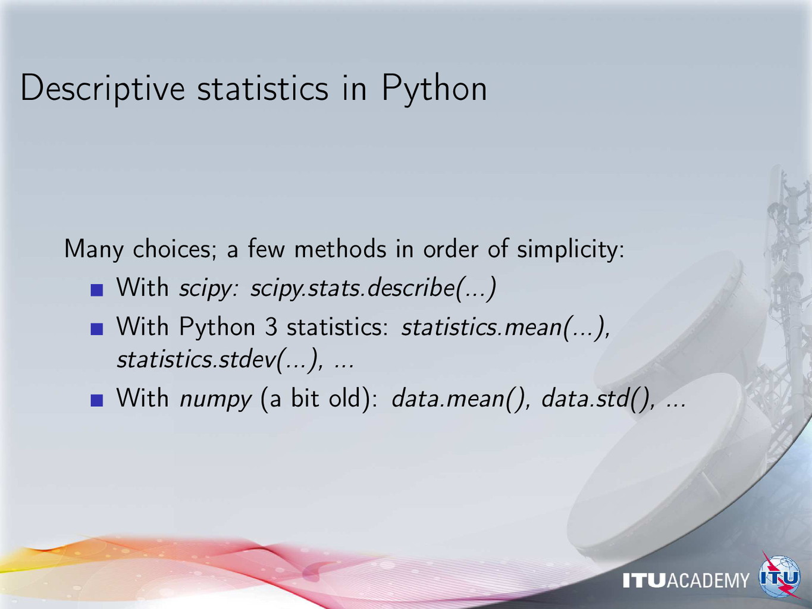

Slide 8
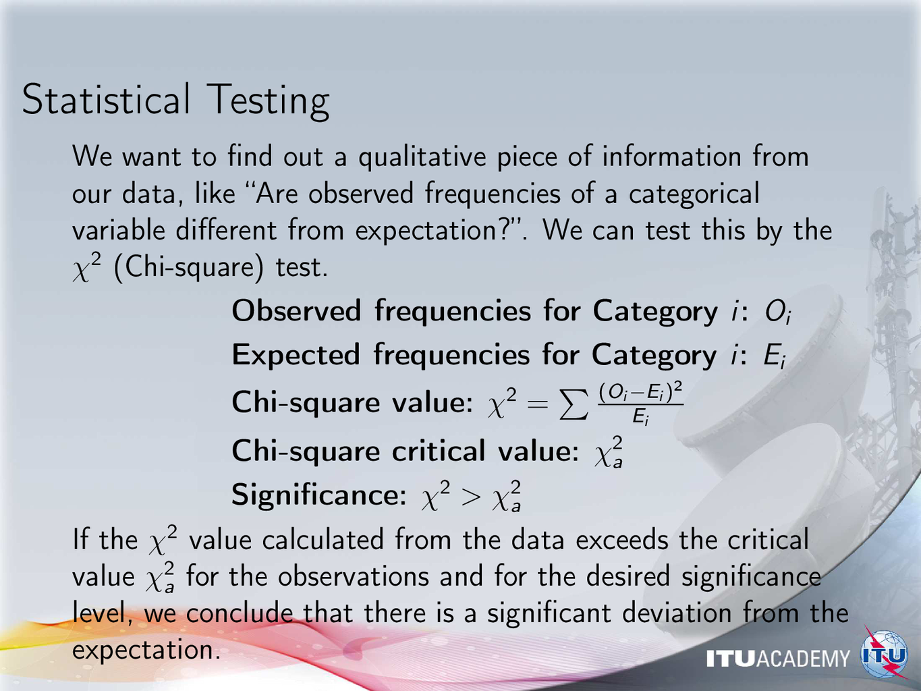
Notes:
Present examples from everyday life:
proportion of female vs. male students, faculty, doctors, politicians, as compared to demographics
other human distributions: age groups, education, etc.

Slide 9
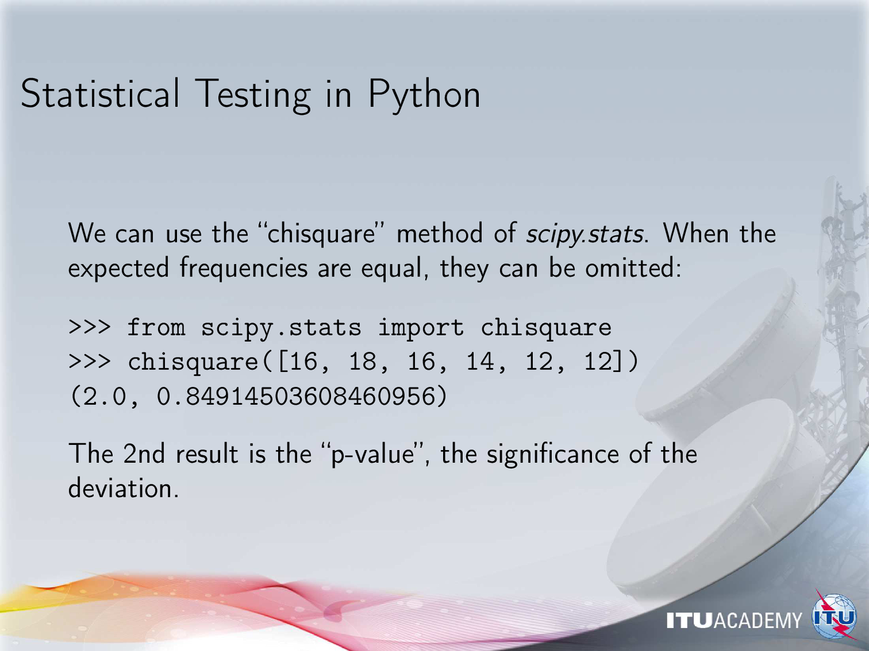
Notes:
Remind the audience about experimenting with the notebooks

Slide 10
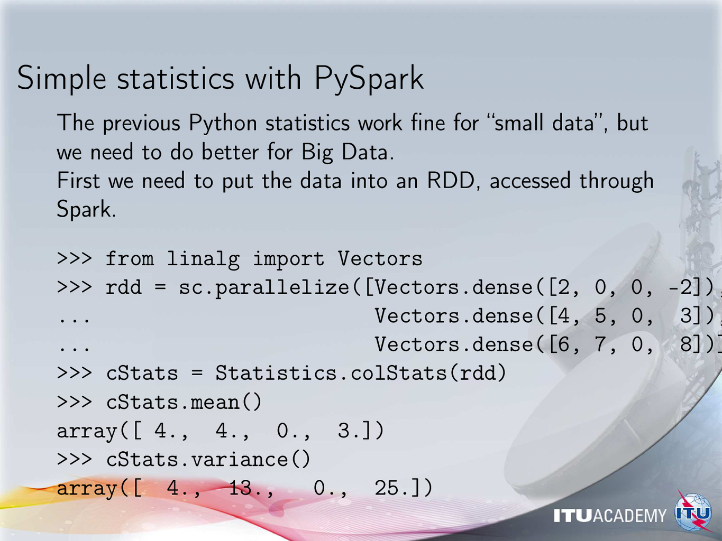
Notes:
Review some Big Data concepts like distributed storage and processing

Slide 11
Descriptive statistics…
We have found these parameters for our data:
Property | Value
Mean of x | 9
Sample variance of x | 11
Mean of y | 7.50
Sample variance of y | 4.125
Correlation between x and y | 0.816
Linear regression line | y = 3.00 + 0.500x
source: https://en.wikipedia.org/wiki/Anscombe's_quartet
Notes:
Warn the audience about looking only at the numbers
Statistics don’t tell everything about the data
In some cases they can be misleading without understanding their origin

Slide 12
Four very different datasets - which one did we use?
The scatter? The curve? The outlier? The singlet?
https://commons.wikimedia.org/w/index.php?curid=9838454
Anscombe, Francis J. (1973) Graphs in statistical analysis. American Statistician, 27, 17–21.
Notes:
The previous descriptive statistics are common for all four datasets!

Slide 13
Careful with descriptive statistics
The accuracy of parameters for each data:
Property | Value | Accuracy
Mean of x | 9 | exact
Sample variance of x | 11 | exact
Mean of y | 7.50 | to 2 decimal places
Sample variance of y | 4.125 | plus/minus 0.003
Correlation between x and y | 0.816 | to 3 decimal places
Linear regression line | y = 3.00 + 0.500x | to 2 and 3 decimal places, respectively
Notes:
Each dataset has the same parameters to high accuracy
We MUST try to visualize the data before jumping to conclusions!

Slide 14
Some more pitfalls
Consider:
errors (noise of measurement)
blunders (mistakes in procedure)
lies (intentional falsehoods)
Big Data helps in one aspect - which one?
Warning by statisticians: the “N - p fallacy” N: independent observations p: repeated observations - much of BD is this!

